Slide 1
COLD APPS & COVER LETTERS
Julie Carroll, Outcomes Lead

Slide 2
LEARNING OBJECTIVES
COLD APPS & COVER LETTERS
Learn how to apply for a job on internet (and get an interview!)
Identify key search engines for finding opportunities
Understand key objectives of a cover letter
Draft a cover letter template

Slide 3
COLD APPS & COVER LETTERS
HOW TO FIND JOBS ON THE INTERNET

Slide 4
COLD APPS & COVER LETTERS
The Big Ones
Corporate Websites!!

Slide 5
COLD APPS & COVER LETTERS
JOB SEARCH HACKS
Apply directly to the company website
Make a list of 30+ companies you love
Set up job alerts
Check their careers site each week
Creative Boolean searches (e.g. by skill)
Offline searching strategies
Community slack channels (e.g. UXPA, GDI)

Slide 6
BOOLEAN SEARCH
Advanced Boolean Searches:
X AND Y
Z OR Q
NOT or use -[word]
site:[website.com] —- for ex: site:evernote.com careers web developer
“[1st-word] [2nd word]”
inurl:xxx —— for ex: inurl:careers
Location: [location] (***to use in Google search: for ex: inurl:careers Location: Boston)
(x AND y) AND (z OR q)

Slide 7
COLD APPS & COVER LETTERS
LINKEDIN LEVEL: PRO
Resume stalking – who else has that role?
Advanced search – find the hiring manager
Do company research
Finding informational interviewees
Messaging when you’re not connected

Slide 8
COLD APPS & COVER LETTERS
ACTIVITY:
FIND A JOB TO APPLY FOR
Post them in Slack

Slide 9
COLD APPS & COVER LETTERS
What did we find?
Titles
Skills
Experience level – what’s OK for GA grads?
Purple Squirrels? (Not!!)

Slide 10
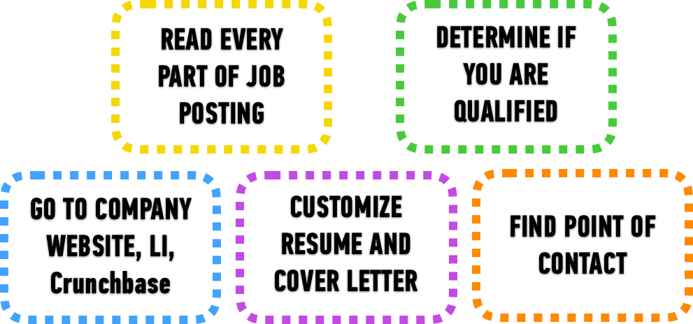
AFTER YOU FIND A JOB OF INTEREST

Slide 11
COLD APPS & COVER LETTERS
COVER LETTERS

Slide 12
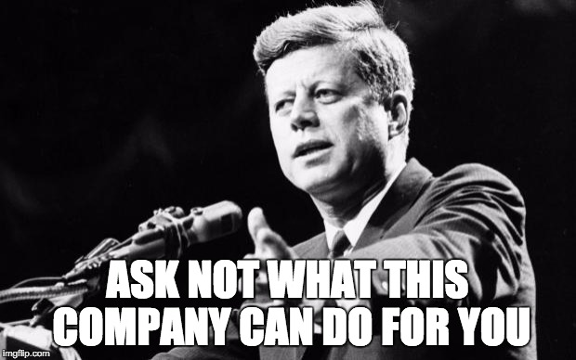
COVER LETTERS
KEY OBJECTIVES:
Why are you excited about THIS job?
Why are YOU the best candidate for this job?

Slide 13
COVER LETTERS: FORMULA
BASIC FORMULA
Here’s why I am excited about this job and this company.
Here’s why I’m a great candidate for this role (specifically!)
Here’s proof that I’d be a great employee for you.

Slide 14
COVER LETTERS: FORMULA
ONE SIMPLE TRICK

Slide 15
COVER LETTERS: FORMULA
Job Description = Cheat Sheet
They give you the answers!

Slide 16
COVER LETTERS: TIPS
Keep it short and sweet (half a page).
Don’t regurgitate your resume. This is your pitch. Make an argument, not a list.
Do include the hiring manager’s name (research to find it!)
Don’t apologize for the skills you don’t have.
Use numbers, measureables, key performance indicators.
Think custom, not canned. Tailor, tailor, tailor. Your reader should feel special.
Use your own voice
Avoid “I” if you
PROOFREAD, PROOFREAD, PROOFREAD
But don’t go too far...like this guy…

Slide 17
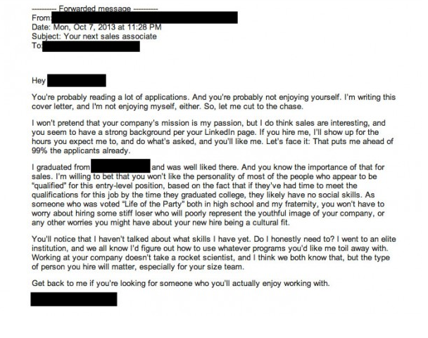
COVER LETTERS

Slide 18
COVER LETTERS
GA EXAMPLE COVER LETTERS

Slide 19
COLD APPS & COVER LETTERS
ACTIVITY:
DRAFT A TEMPLATE COVER LETTER

Slide 20
HELPFUL ARTICLES
YOUR RESUME
How to Write a Cover Letter: 31 Tips You Need to Know , The Muse: https://www.themuse.com/advice/how-to-write-a-cover-letter-31-tips-you-need-to-know
Want a Winning Cover Letter? Try this: https://www.themuse.com/advice/want-a-winning-cover-letter-try-this

Slide 21
Q&A
COLD APPS & COVER LETTERS

